Slide 1
PROJECT PROPOSAL
Presentation
Group 4
Notes:
Ankit Thapar:
Welcome everyone, today our group, comprising of developers, innovators, designers and analysts, has gathered to present the proposal for our application, the application that we think has the power to solve all the issues related to the Marina business. First of all, we will start by introducing our team members.

Slide 2
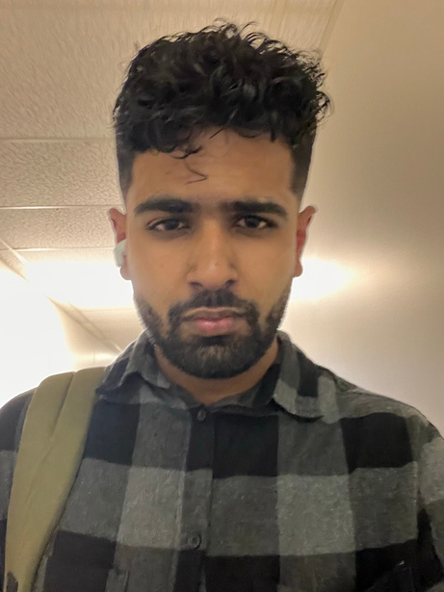
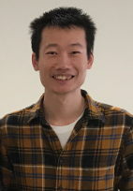
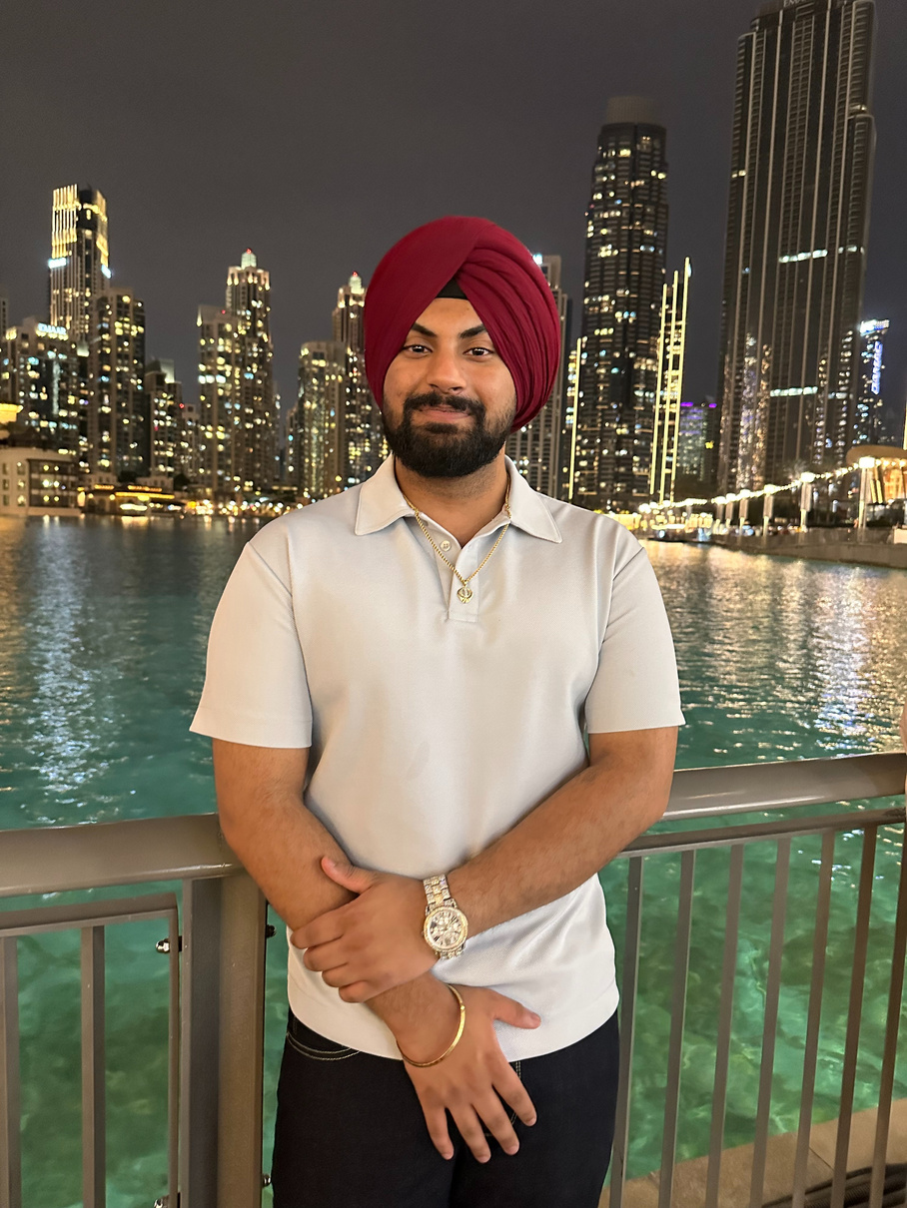
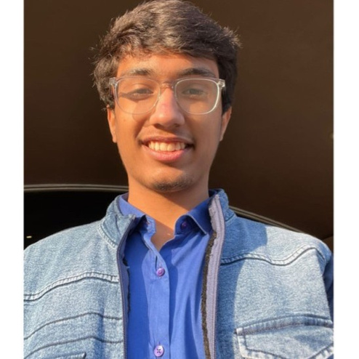
OUR TEAM MEMBERS
ANKIT THAPAR
MINGMING MA
YUVRAJ SINGH
KRISH JANI
Backend Developer/
System Architect
Full Stack Developer
UI/UX Designer
Quality Assurance Analyst
Notes:
Ankit Thapar:
Starting from myself, my name is Ankit. I am the backend developer and System architect for my team. Since my high school days, I have always been passionate about coding. I have always been passionate about working on projects and bringing ideas to the real world which can help better the lives of people. Before joining Seneca, I used to do iOS App development, primarily focusing on the Swift programming language. I created a game which I then ran on my iPhone, and it was like one of the most joyful experiences of my life. I never imagined that someday I would be playing my own design game on my iPhone. This time, I have joined my team as a backend developer and system design architect, and I think my skillset and experience will help my team to implement the functionalities and complete the project successfully. Now, my team member, Mingming Ma will introduce himself.
Mingming Ma:
Thanks Ankit. I'm Mingming Ma. My tech journey began with a fascination for front and back-end development. Before joining Seneca, I explored various software development areas, but the synergy of front and back-end processes really captivated me. This led to my current full-stack role in our team, which I approach with expertise and passion. My key contribution is my 'time mind' approach, emphasizing efficient, timely collaboration. This has significantly enhanced our team's productivity and project quality. I excel in blending front and back-end development, creating cohesive digital experiences. This skill, coupled with my teamwork, is vital in our group, enabling us to tackle diverse challenges effectively. As we continue at Seneca, I'm excited to keep applying my full-stack capabilities and collaborative mindset, driving our team towards innovative solutions and success. Now, my team member, Yuvraj will introduce himself.
Yuvraj Singh:
Thanks, mingming, Hi, I’m Yuvraj Singh, the UI/UX Designer on our dynamic team. My primary responsibility involves designing the user interface for our application. This role is a blend of art and technology — it’s where I get to channel my creativity into creating interfaces that are not only visually appealing but also intuitive and easy to navigate. I focus on understanding our users, their needs, and how they interact with our application. My goal is to craft experiences that feel natural and seamless. I implement design thinking and a user-centric approach to solve complex problems within the user interface, ensuring that every design decision enhances the user's interaction with our product. My expertise lies in creating interfaces that are not just functional but also delightful to use. I believe that a great user experience drives engagement and ultimately, customer satisfaction. In my toolbox, you'll find industry-standard design software like Adobe XD, Sketch, and Figma, which I use to bring our ideas to life. With these tools, I map out user flows, create wireframes, and build interactive prototypes. The user interface is the bridge between our users and the powerful technology our team develops, and I take pride in being the architect of that bridge. Now, my team member, krish will introduce himself.
Krish Jani:
I'm Krish Jani and I'm thrilled to be a part of this dynamic team as a QA tester. With a strong background in quality assurance, I specialize in meticulously testing software to ensure its functionality, reliability, and user-friendliness. My skill set includes proficiency in various testing methodologies, such as manual and automated testing, along with expertise in identifying and resolving issues to enhance product quality. I bring a keen eye for detail, a methodical approach to problem-solving, and a commitment to delivering high-quality, bug-free software that meets and exceeds user expectations. I'm excited to collaborate with all of you to achieve our goals and deliver exceptional products. Now my friend Ankit will discuss what problems clients are facing.

Slide 3




Problem
inefficient management and tracking of various systems, including management of clients, invoicing, payment processing, and service ticket creation
Inefficient Client Management
Lack invoicing system
Inefficient payment processing
Notes:
Ankit Thapar:
Now, we will discuss the actual problem that the client is facing. After analyzing the case study, we came to a conclusion that the problem that the client is facing is that they lack an efficient system to manage the data related to the clients that are registered to their marina which, in turn, causes problems in invoicing, payment processing, service ticket creation (Marine workshop) and the other services that Marina provides. In technical terms, they lack a proper database management system and because of that they are not able to share the data among the different segments of the marina like the Restuarant that the marina operates, and the Marine workshop operated by the Marina. Because of that they are facing issues in keeping track of the clients and because of the failure to keep track of the clients and share that data among different areas of their business, they are having problems in sending invoices and the payment processing. This inefficient management of the systems can even lead to the failure of the whole business as a Marina. Now my friend, Mingming Ma will discuss what can be the possible solution.

Slide 4




Solution
‘provide access to an efficient database management system, helping to track clients and transactions accurately, which will help automate and streamline the process of various systems, ensuring accuracy and efficiency’
Notes:
Mingming Ma:
Thanks Ankit. The solution that we have identified as a group is to provide client with access to an efficient database management system which will help them to track clients and the transactions accurately. The idea is to create a database management system which can be shared among all the segments of the Marina like among the Boat slip staff members, the Restuarant management and the Marine Workshop management, which in turn, will solve the problems of invoicing, payment processing etc. For example, for proper restaurant management, the staff needs to have information about the clients whether they are one time or permanent. This is because one-time clients are charged at the time of the service whereas the permanent clients are charged monthly as part of their monthly invoices. So, the client needs some way to store the data about the clients and there should be a way to share the data among the business areas of the marina. That's why a common database management system is needed to solve the issues of the client and run a successful business. And now, let me turn it back to Ankit.

Slide 5


Solution Details
Notes:
Ankit Thapar:
Now, we will discuss the solution in detail and see the different use cases that we have identified.

Slide 6



Ankit Thapar
Client Management
Use Case :
Add a client looking for boat slip
Order management
Use Case :
Place an order for the required supplies needed by the Marine Workshop.
Notes:
Ankit Thapar:
First of all, we focused on the client management segment of the solution. For the successful running of the Marina, a system is needed to keep track of the client data which can be shared among the different segments of the Marina like the Marine Workshop, Restuarant etc. The client data is required by every segment of the business and when it is updated at one end, it should be updated among every segment of the Marina. For that, a common data management system will be needed. In addition to that, I focused on the management of the orders part of the solution. The client needs a system to keep track of the orders from different suppliers. The Marine Workshop manager may want to order some supplies to fulfill the client orders and he may want to make orders to different suppliers. So, a system is needed to manage the orders made to the different suppliers. This is important because the Marine Workshop manager may want to review supplies that he ordered, check the total of the order etc. Both the client management and the order management system are necessary for the Marina business to run successfully. Now my team member, Mingming Ma will discuss other use cases.

Slide 7
Mingming Ma
Invoice Management
Use Case :
Summarize Outstanding Transactions and Invoice Clients
Financial Transaction Management
Use Case :
Recording Financial Transactions in the Marina Management System
Notes:
Mingming Ma:
Thanks Ankit, Addressing Marina's challenges of inefficient client data management, I suggest a strategic two-part solution. The primary issue stems from the lack of an integrated system for managing client information, affecting invoicing and service management across various segments like the restaurant and marine workshop. First, a comprehensive system for RBM Office Staff is essential. This system will streamline monthly invoicing for clients with permanent leases and integrate with client accounts from different sectors, such as the restaurant and workshop. This interconnectedness ensures accurate billing, improving client satisfaction and operational efficiency. Second, the Harbour Master requires a specialized solution to efficiently record financial transactions in the Marina Management System. This system needs to handle diverse transactions, including boat leases and various marina services. A priority is creating an intuitive, easy-to-use interface for the Harbour Master, facilitating quick and accurate transaction logging. In conclusion, these interconnected systems—one for managing client transactions and the other for financial recording—are vital for the Marina's smooth operation. Their implementation will significantly improve management efficiency, ensuring integrated, streamlined operations across the Marina's various services. Now my team member, Yuvraj will discuss other use cases.

Slide 8
Yuvraj Singh
Service Ticket Management
Use Case :
Create Boat Repair Service Ticket and saving to the system
Boat Booking Management
Use Case :
Book a boat with additional services and saving the order booking.
Notes:
Yuvraj Singh
Thanks, mingming, here are my cases that I would like to shed light on, starting off with- “Service Ticket Creation Use Case”: In this use case, the marina introduces a centralized system for handling service requests, which is critical for operational effectiveness. The main menu offers various functions including the creation of a service ticket, an essential feature that streamlines the logging and management of boat repair issues. This system is not only a tool for organization but also a means to ensure swift and accurate service, directly impacting client satisfaction. Its ability to consolidate service requests in one interface allows for better tracking, prioritization, and resolution of maintenance tasks, making it an indispensable tool for maintaining the marina's service standards. And another one is “Boat Booking with Additional Services Use Case”: This use case addresses the modern customer's desire for a tailored boating experience. By integrating boat reservations with the option to add services like equipment rental and catering, the marina provides a comprehensive online system that simplifies the booking process. The UI design's focus on intuitive navigation and instant confirmation caters to the user's need for convenience and efficiency. This feature not only enriches the customer experience but also showcases the marina's adaptability to evolving consumer expectations, cementing its position as a forward-thinking business. Talking about their Importance in Systems: Both use cases are vital for the marina's digital infrastructure. The Service Ticket Creation use case ensures that the internal operations run smoothly, boats are well-maintained, and service disruptions are minimized. Meanwhile, the Boat Booking with Additional Services use case directly influences the customer's journey, from consideration to purchase, enhancing the customer's interaction with the marina's services. Together, they form a cohesive system that boosts the marina's efficiency and customer-centric approach, ensuring that the business can thrive in a competitive marketplace by leveraging technology to meet and exceed customer expectations. Now, my groupmate Krish will explain his use cases.

Slide 9
Krish Jani
Payment Processing
Use Case :
Processing the payment and adding it to the system.
Project management
Use Case :
Adding the company’s new projects to the system.
Notes:
Krish Jani:
Thanks Yuvraj, two critical challenges I encounter involve addressing specific problems within our system. First use case was to ensure the flawless processing and integration of payments stands as a key concern. To tackle this, I meticulously create and execute test cases to guarantee secure and seamless payment transactions within our application. Moving on to the second use case, the complexity arises when adding the company’s new projects to our system. This task demands thorough testing to prevent any disruption while integrating new project data, ensuring it seamlessly aligns with the existing system functionalities. These use cases pinpoint the crucial areas where my role as a QA Tester plays a vital role in maintaining the reliability and functionality of our software. Let Ankit guide you further.

Slide 10

Use Case Table
For the use case table, refer to the written proposal.
Notes:
Ankit Thapar:
We discussed all the use cases and why these use cases are important and how they contribute to the solution. For further information, you can refer to the use case table which is given in the written proposal.

Slide 11


Key
Personnel
Notes:
Ankit Thapar:
Now, we will discuss our group member roles and the skillsets and will see how our group is competent enough to successfully complete the application.

Slide 12

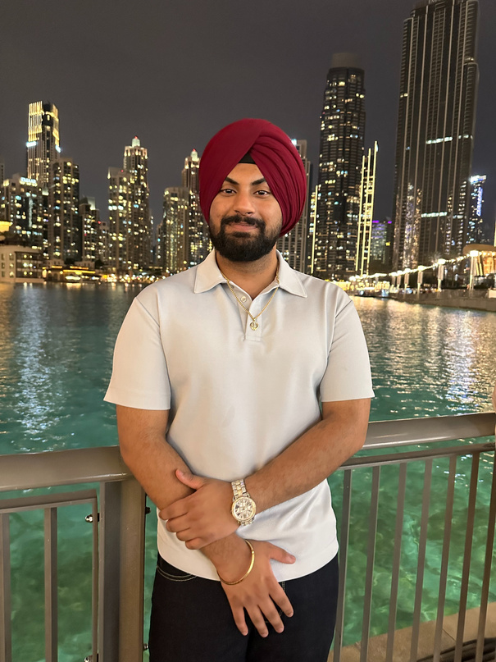


OUR ROLES
 | ROLE | RESPONSIBILITIES | SKILLSET
ANKIT THAPAR | SYSTEM ARCHITECT | Responsible for system design, the way the system responds to the user events and the database design for the application. | Proficiency in designing scalable and efficient systems. Knowledge of database design. Ability to create a solid technical architecture.
MINGMING MA | FULL STACK DEVELOPER | Responsible for developing the web site for the application, both the front-end and the back-end part. | HTML, CSS, JavaScript Front-end framework/library (e.g., React, Angular, Vue.js) Server-side scripting language (e.g., Node.js, Python, Ruby)
YUVRAJ SINGH | UI/UX DESIGNER | Responsible for designing the user interface of the application, creating visually appealing and positive user experience. | Experience in creating user-friendly interfaces. Design thinking and user-centric approach.
KRISH JANI | QUALITY ASSURANCE ANALYST | Responsible for developing different test cases for the application and making sure that the application is bug free before it is delivered to the user. | Proficient in manual and automated testing. Experience in creating test cases and conducting thorough testing. Bug tracking and reporting skills.
EXTERNAL HIRED MEMBER | PROJECT MANAGER | Responsible for creating a project plan and effective timelines to complete the project at a correct pace. | Experience in software development project management. Strong communication and coordination skills. Ability to manage timelines and resources effectively.
Notes:
Ankit Thapar:
Starting from myself, I am working as a System Architect for my team. I will also be contributing somewhat also as a Backend developer. Going to my technical background, I have a strong foundation in database design. As part of my program at Seneca, I have completed beginner level (DBS222) and the advanced level (DBS322) courses. I also have hands on experience working on different projects such as implementing an employee management system using MySQL as the database and connecting it to a C++ application. In addition to that, I have completed the SYD366 and SYD466 courses, which gives me a strong foundation in system design. I think I bring a complete skillset for being a System Architect. Now, my team member Mingming Ma will talk about his skillsets and how he fits well into the team.
Mingming Ma:
Thanks Ankit, I am working as a Full Stack Web Developer. My journey in web development has been fortified through comprehensive coursework at Seneca, including beginner (WEB222) to advanced level (WEB322 and WEB422) web development courses. I am proficient in HTML, CSS, and JavaScript, and skilled in frameworks like React. On the back-end side, my experience extends to server-side scripting with Node.js and Python, and I am familiar with web application frameworks such as Express.js. My projects have involved developing user interfaces, implementing authentication systems, and working with APIs. Additionally, my database integration skills include working with MySQL, PostgreSQL, and MongoDB. With two years of web development experience and a coop at the Ontario School Board, I bring a comprehensive skillset to effectively implement both front-end and back-end aspects of our application. Now, my team member Yuvraj will talk about his skillsets and how he fits well into the team.
Yuvraj Singh:
I'm Yuvraj, I handle the UX/UI aspect in the SYD 466 group project. My role involves the strategic design of user interfaces, particularly for a marina management system that simplifies service ticket creation and enhances the boat booking process. My academic journey in Computer Programming and Analysis, paired with practical experience in web development at the Ministry of Education, has honed my ability to craft intuitive and accessible digital solutions. In my individual assignments, I am responsible for the UX designs that streamline operations for RBM staff, enabling them to efficiently manage repair services and customer engagements through a centralized interface. My designs are informed by a keen understanding of user-centric principles and a deep dive into backend processes, ensuring that every touchpoint is optimized for ease and functionality. In my toolbox, you'll find industry-standard design software like Adobe XD, Sketch, and Figma, which I use to bring our ideas to life. In my professional career I have worked as a web developer in ministry of education and a currently working as social media content editor for Seneca, bring a blend of technical acumen and creative flair to our group project, for my hobbies I like to spend time learning about astronomy and photography. These hobbies not only fuel my passion but also broaden my perspective, allowing me to infuse my designs with a sense of narrative strength and visual composition that resonates with users on a profound level. Now, my team member Krish will talk about his skillsets and how he fits well into the team.
Krish Jani:
Thanks, Yuvraj, I handle the QA testing part of the team. I acquired my QA testing skills through a combination of structured learning and hands-on experience. Formal training courses provided me with foundational knowledge, complemented by practical application within real-world projects, allowing me to hone my expertise in manual and automated testing techniques. It is pivotal in ensuring the overall quality and reliability of our software. I serve as a gatekeeper, meticulously crafting and executing test cases to identify potential bugs and issues before our application reaches the end user. My responsibilities encompass both manual and automated testing, leveraging diverse methodologies to thoroughly assess our system's performance. My skill set plays a crucial role in the team's success. Proficiency in manual and automated testing allows me to cover a wide range of scenarios, ensuring comprehensive test coverage. Creating detailed test cases and conducting thorough testing procedures are essential for detecting and resolving issues early in the development cycle. Moreover, my adeptness in bug tracking and reporting facilitates effective communication with the development team, enabling swift resolution of identified issues. Overall, my expertise as a QA Tester significantly contributes to delivering high-quality, error-free software, enhancing the team's efficiency and the end user's experience. Now I’ll pass it on to Ankit.

Slide 13
Budget Plan
Notes:
Ankit Thapar:
Now, my friend Krish Jani will discuss the budget plan and how we will manage to complete the whole application within the amount allocated by the client.

Slide 14

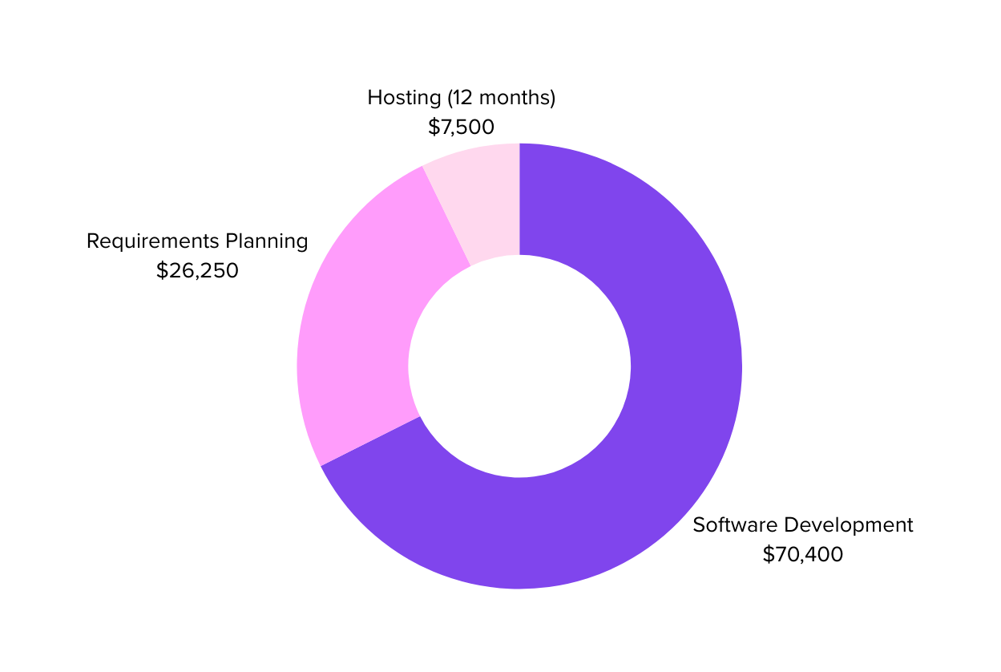
$ 96,500
(excluding Hosting)
Notes:
Krish Jani:
Thanks Ankit, as we all are developers, it was difficult to calculate the budget that we will need to implement the project. But using different resources, contacting some project management professionals and according to our best understanding, we came up with a budget of around $96,650. excluding the fees of hosting. The estimated time frame that we need to complete the application is around 2-3 months. The budget that we calculated is divided into 3 phases:
The first phase is the Requirements gathering and the analysis part. This involves conducting interviews with the stakeholders, creating a system design which involves designing the database schema. In addition to that, it involves designing a project plan, risk assessment and mitigation planning. The rough estimate for this Phase is around 26,000 dollars.
The second phase involves the software development and the testing part. This involves actually designing the application, both the front end and the back end. In addition to that, it involves designing the test cases, including all the edge cases so that the application is delivered bug free to the client. In addition to that, it also involves the deployment part which involves deploying the system to production and training the staff on the new system. The rough estimate for this phase is 70,000 dollars. More details are given in the written proposal.
The third phase is the hosting phase, which we will only consider if our proposal gets selected for the actual implementation. The rough estimate for hosting the application for 12 months, including the one-time cost is 8000 dollars.
That's how the budget is broken down. I am sure that our group will be able to implement all the functionalities within the budget. Now my friend Yuvraj will summarize everything.

Slide 15

SUMMARY
To make a successful application, two things matter:
all functionalities that needs to be implemented must be identified
one should have the required skillset to implement those functionalities.
We, as a group, satisfy both the conditions.
Notes:
Yuvraj Singh
We, as a team, believe that for a successful application two things matter:
1. all the functionalities and the use cases that needs to be implemented must be identified
2. one should have the required skillset to implement those functionalities within the budget and a considerable time frame.
We, as a team, adopted a holistic approach to solve the problem and focused on all the segments of the business to come up with a complete solution. We analyzed the problem and identified all the use cases or the functionalities that need to be developed for the successful operation of the Marina business. Going to the skillset part, we, as a team, have the complete skillset to develop the application and test the application so that it is delivered bug free to the client. The only external member that our team requires is a Project Manager for the project analysis. In addition to working on the course projects, some of the members also have professional experience. One of the team members, Mingming ma has experience of working as a web developer professionally. One of the team members, Ankit, has been a Hackathon finalist and has experience working on projects and even on how to manage the project so that it can be completed within a specific time. Apart from that, the budget that we estimated is within the amount allocated by the client and the estimated time to complete the project is considerable, which is around 3 months. In a nutshell, we have analyzed all the functionalities that need to be developed and we also have the required skillset to develop those functionalities. That's why I think our group is the best fit to be given the contract to develop the application.

